Slide 1


Presentation
On
Driver Assistance System for Collision Detection
PG-Diploma in Embedded Systems and Design
(PG-DESD)
C-DAC, ACTS (Pune)
Guided By:
Mr. Bhupendra S.
Submitted By:
Karan Solanki (240340130023)
Lalit Deshpande (240340130028)
Onkar Chougale (240340130031)
Prasad Kulkarni (240340130035)

Slide 2


Driver Assistance System for Collision Detection
This presentation explores the development of a Vehicle Collision Detection System. This innovative system utilizes the power of STM32F407VGT6 microcontrollers and the widely recognized CAN protocol. The system aims to enhance automotive safety by providing a reliable and timely warning mechanism to prevent collisions.

Slide 3

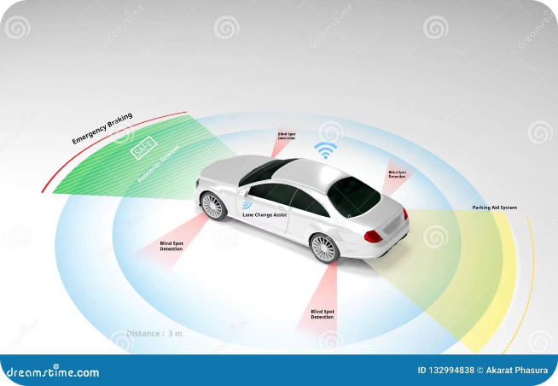
Project Objectives and Motivation
1
Enhance Automotive Safety
2
Reduce Accidents
The primary objective of this project is to enhance automotive safety by developing a reliable collision detection system.
By providing timely warnings to drivers, the system aims to significantly reduce the incidence of car accidents.
3
Improve Driver Awareness
4
Leverage Advanced Technology
The system increases driver awareness by providing real-time information about potential collisions.
The project leverages cutting-edge technologies like STM32F407VGT6 microcontrollers and CAN protocol for optimal performance.

Slide 4
STM32F407VGT6 Microcontroller and CAN Protocol
STM32F407VGT6
CAN Protocol
This high-performance microcontroller is chosen for its powerful processing capabilities, multiple communication interfaces, and robust peripherals.
The CAN protocol is an efficient and reliable communication protocol specifically designed for automotive applications. It allows for real-time communication between different electronic modules within a vehicle.

Slide 5
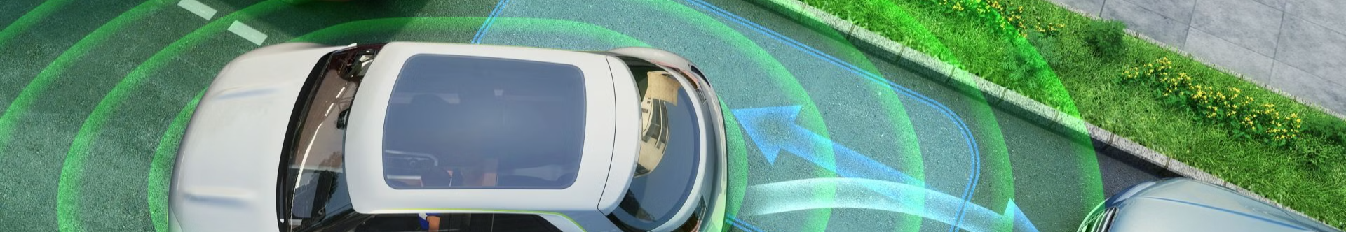



Sensor Data Acquisition
Ultrasonic Sensors
Data Processing
Alert Generation
Ultrasonic sensors are used to detect objects in the vicinity of the vehicle. They emit sound waves and measure the time it takes for the waves to return, providing distance information.
The microcontroller processes the raw data received from the sensors to calculate distance and speed of nearby objects.
Based on the processed data, the system generates an alert if a potential collision is detected.

Slide 6

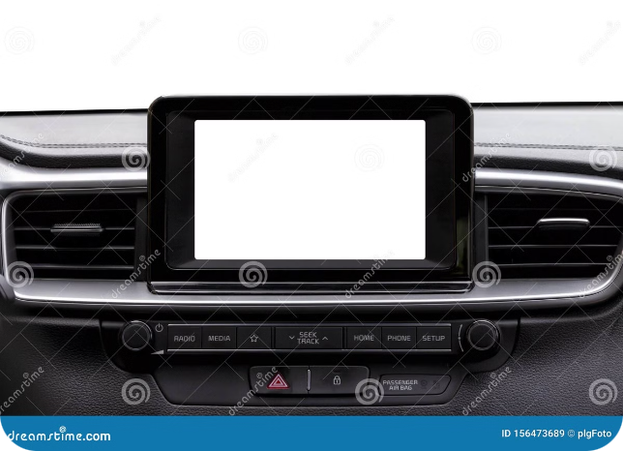
Real-time Data Transmission
1
Sensor Data
Sensor data is collected and processed by the STM32F407VGT6 microcontroller.
2
CAN Bus Transmission
The processed data is transmitted over the CAN bus to the display unit and buzzer.
3
Display and Buzzer Activation
The display unit shows distance and speed information, while the buzzer emits an alert if a potential collision is detected.

Slide 7


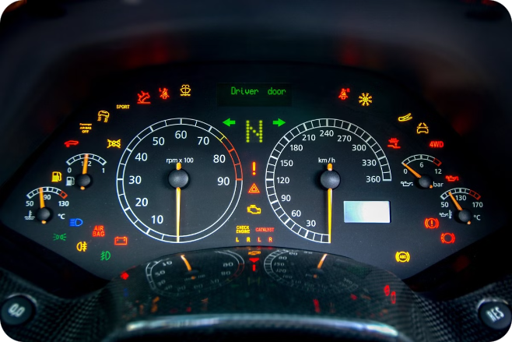


Collision Warning System
Audio Warning
A loud and distinctive buzzer sound alerts the driver of a potential collision.
Visual Warning
An LCD display shows the distance and speed of nearby objects, providing visual feedback to the driver.
Alert Threshold
The system is programmed with adjustable alert thresholds for different speed ranges, ensuring appropriate warning levels based on driving conditions.

Slide 8


Hardware Setup and Integration
STM32F407VGT6 Microcontroller
The heart of the system, responsible for data processing and communication.
Ultrasonic Sensors
Used to detect objects in the vicinity of the vehicle.
CAN Transceiver
Facilitates communication between the microcontroller and the display unit and buzzer.
LCD Display
Provides visual feedback on detected objects and potential collisions.
Buzzer
Emits an audible warning signal in case of a potential collision.

Slide 9

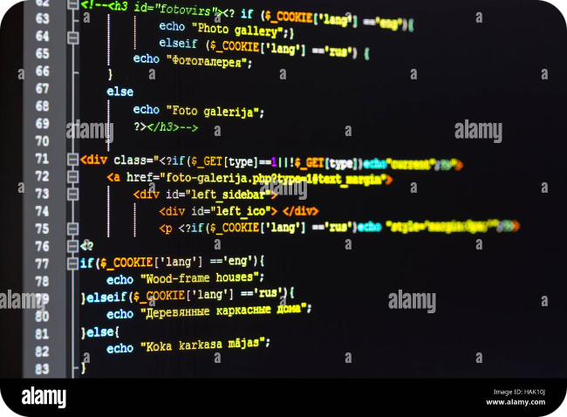
Software Implementation with FreeRTOS
Real-time Operating System
Sensor Data Acquisition
Software modules are developed to acquire data from the ultrasonic sensors and process it to detect potential collisions.
FreeRTOS is used to manage the system's resources and ensure efficient and timely execution of tasks.
CAN Communication
Display and Buzzer Control
Software libraries are implemented to handle communication over the CAN bus, ensuring reliable data transmission.
Software routines are written to control the LCD display and buzzer, providing appropriate visual and auditory warnings.

Slide 10
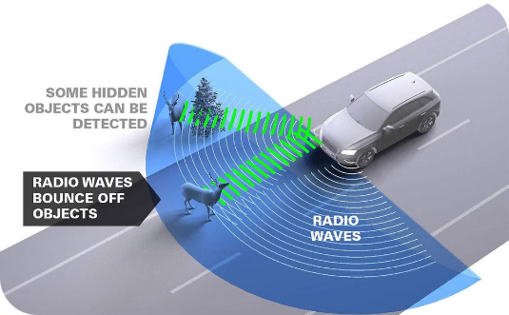
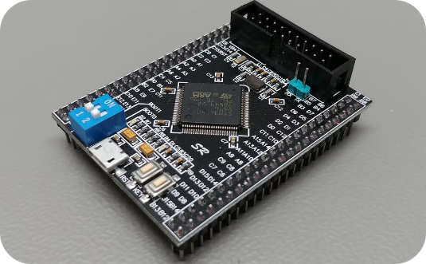
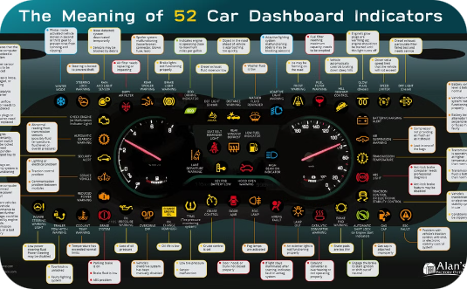
System Architecture and Design
Sensor Layer
Processing Layer
Warning Layer
The sensor layer comprises ultrasonic sensors that acquire distance information about nearby objects.
The processing layer, based on the STM32F407VGT6 microcontroller, handles sensor data processing, collision detection, and alert generation.
The warning layer includes the LCD display and buzzer, responsible for providing visual and auditory warnings to the driver.

Slide 11


Outcomes and Future Potential
1
Enhanced Automotive Safety
The system successfully demonstrates a reliable collision detection mechanism, enhancing automotive safety.
2
Potential for Integration
The system can be integrated into existing automotive systems, further enhancing safety and driver assistance.
3
Future Development
Future research can explore the integration of additional sensors, advanced warning algorithms, and autonomous braking capabilities.

